Slide 1
Distributed Transaction Processing

Slide 2
Distributed Transactions
Local transactions
Access/update data at only one database
Global transactions
Access/update data at more than one database
Key issue: how to ensure ACID properties for transactions in a system with global transactions spanning multiple database

Slide 3
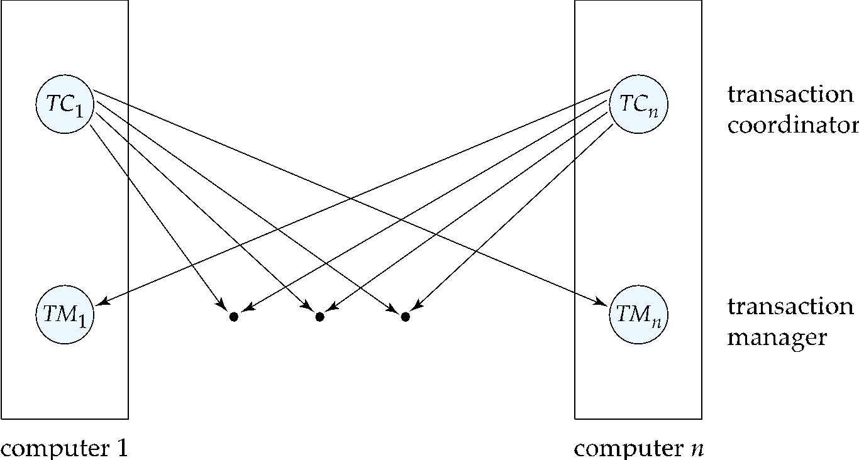
Distributed Transactions
Transaction may access data at several sites.
Each site has a local transaction manager
Each site has a transaction coordinator
Global transactions submitted to any transaction coordinator

Slide 4
Distributed Transactions
Each transaction coordinator is responsible for:
Starting the execution of transactions that originate at the site.
Distributing subtransactions at appropriate sites for execution.
Coordinating the termination of each transaction that originates at the site
transaction must be committed at all sites or aborted at all sites.
Site4
TC4
Site1
TM4
Site3
TC1
TC3
TM1
TM3
Question 1:Site 3 has initiated Transaction T to transfer Tk. 1000 from account P at site 4 to account Q at site 2. Write down the tasks of TC3.
Site2
TC2
TM2

Slide 5
Distributed Transactions
Each local transaction manager responsible for:
Maintaining a log for recovery purposes
Coordinating the execution and commit/abort of the transactions executing at that site.
Site4
TC4
Site1
TM4
Site3
Discussion 2:
Site 3 has initiated Transaction T to transfer Tk. 1000 from account P at site 4 to account Q at site 2 and transaction T1 to add Tk. 5000 to account R at site 3.
Write down the tasks of TM3.
TC1
TC3
TM1
TM3
Site2
TC2
TM2

Slide 6
Coordinator
Transaction: Transfer Tk. 5000 from account A to account B. A in site 2 and B in site 3. Transaction has been initiated from site 1.
Problem to solve 1: Write the transaction with lock
Site 1
Site 2
TC 1
TC 2
TM1 1
TM 2
LOG
LOG
<Start T> by TC1
Lock (A) request by TC1 granted by TM2
READ (A)
A = A- 5000
Write (A)
Lock (B) request by TC1 granted by TM3
READ (B)
B=B+5000
WRITE (B)
COMMIT (T)
UNLOCK (A)
UNLOCK (B)
Site 3
TC 3
TM 3
LOG

Slide 7
Coordinator
<Start T> by TC1
Lock (A) request by TC1 granted by TM1
READ (A)
A = A- 5000
Write (A)
Lock (B) request by TC1 granted by TM2
READ (B)
B=B+5000
WRITE (B)
COMMIT (T)
UNLOCK (A)
UNLOCK (B)
Site 1
Site 2
TC 1
TC 2
TM1 1
TM1 2
LOG
LOG
Site 3
TC 3
TM1 3
LOG
Commit protocols are used to ensure atomicity across sites
A transaction which executes at multiple sites must either be committed at all the sites, or aborted at all the sites.
Cannot have transaction committed at one site and aborted at another
Question 2: Why is COMMIT protocol needed to COMMIT the transaction T initiated by TC1? Explain.

Slide 8
Distributed DBMS Environment
Organization 1
Site 1
Site 2
Site 5
Communication
Network
Organization 2
Site 4
Site 3

Slide 9
Persistent Messaging
Atomicity issue
Once transaction sending a message is committed, message must guaranteed to be delivered
Guarantee as long as destination site is up and reachable, code to handle undeliverable messages must also be available
e.g., credit money back to source account.
If sending transaction aborts, message must not be sent

Slide 10
Error Conditions with Persistent Messaging
Code to handle messages has to take care of variety of failure situations (even assuming guaranteed message delivery)
E.g., if destination account does not exist, failure message must be sent back to source site
When failure message is received from destination site, or destination site itself does not exist, money must be deposited back in source account
Problem if source account has been closed
get humans to take care of problem

Slide 11
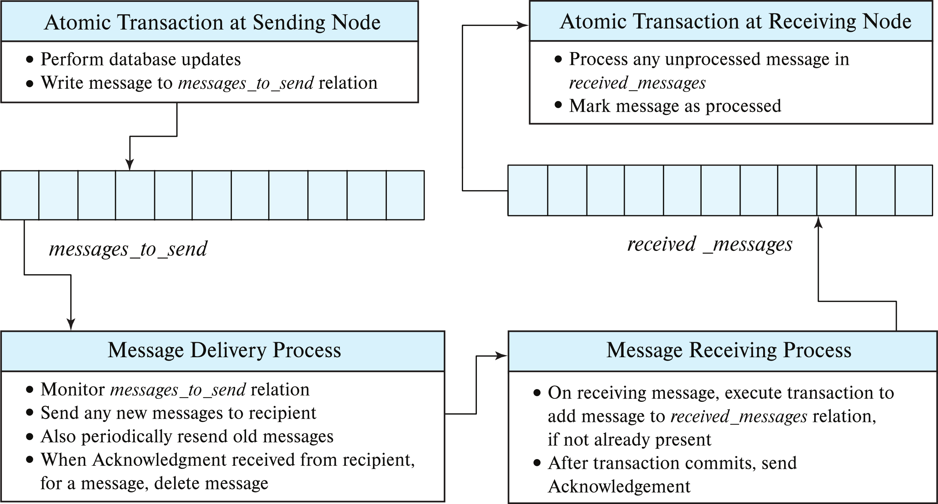
Question: There is an account A under organization 1 and an account B under organization 2. Transfer Tk. 5000 from account A to account B using persistent messaging protocol.
Step 1: READ (A)
A= A – 5000, Write (A), Commit
Step 2: Write persistent message message-A with ID to messageto_send relation
Step 3: Send message-A to organization 2
Step 4: after receiving of ack, the message is deleted from the message_to_send relation
Step 1: Receive message-A and execute transaction as:
Read (B), B = B+5000, Write(B), Commit and Writes to received_message relation
Step 2: After transaction commit, status of mark is set as ‘Processed’
Step 3: Send ack to organization 1

